Slide 1
DIGITAL LOGIC DESIGN · FINAL PROJECT
PROJECT TEAM : 14
Design of SR Latch, D, JK & T Flip-Flops
VALLURI YUSHWADEEP REDDY
Roll No: 2620040077
1
2
VOONNA SAI BHANUMATHI
Roll No: 2620040169
with Level-Triggered vs Edge-Triggered Operation, simulated in Logisim
NUNNA NAMAN VENKAT
Roll No: 2620040105
3
Faculty Guide
Thanmoya Ghosh Ma'am
Section: 4
SIRIGIRI NARASIMHA REDDY
Roll No: 2620040086
4

Slide 2
Introduction
Why memory elements?
S
J
Combinational circuits depend only on present inputs; sequential circuits also remember past state.
Latches and flip-flops are the 1-bit memory cells behind registers, counters and RAM.
Objective: design and simulate SR latch, D, JK and T flip-flops in Logisim, and compare level vs edge triggering.
SR Latch
JK Flip-Flop
Basic set / reset memory
Universal, no invalid state
T
D
T Flip-Flop
D Flip-Flop
Toggles on every pulse
Stores the data input

Slide 3
SR Latch
S' | R' | Q next | State
0 | 0 | 1 / 1 | Invalid
0 | 1 | 1 | Set
1 | 0 | 0 | Reset
1 | 1 | Q | Hold
Cross-coupled NAND gates
S'
NAND
Q
How it works
NAND
Q'
Two cross-coupled NAND gates feed each output back to the other gate.
Active-low inputs: S' = 0 sets, R' = 0 resets. No clock, so it is level-sensitive.
S' = R' = 0 forces both outputs high and is avoided.
R'

Slide 4
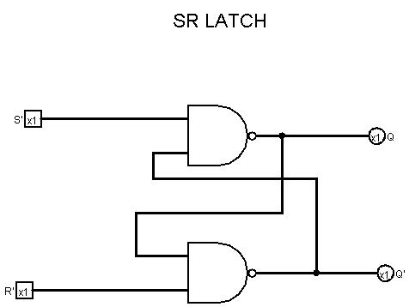
Logisim: SR Latch
Working
S' = 0, R' = 1: Q = 1 (set).
S' = 1, R' = 0: Q = 0 (reset).
S' = R' = 1: output holds.
S' = R' = 0: invalid, both outputs 1.

Slide 5
JK Flip-Flop
J | K | Q next | Action
0 | 0 | Q | Hold
0 | 1 | 0 | Reset
1 | 0 | 1 | Set
1 | 1 | Q' | Toggle
Symbol (edge-triggered)
J
Q
CLK
JK
Key points
K
Removes the SR invalid state: J = K = 1 toggles the output.
Characteristic equation: Q next = J·Q' + K'·Q.
Level-triggered JK suffers race-around; edge or master-slave triggering fixes it.
Q'
Clock triangle = edge-triggered

Slide 6
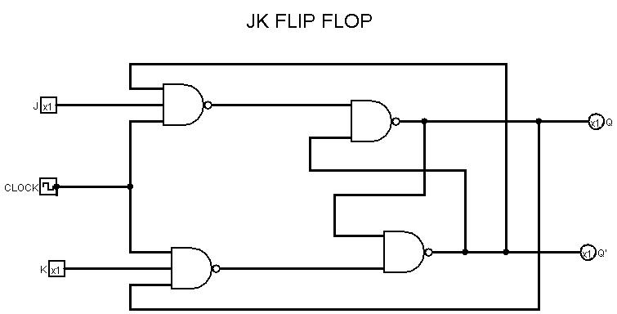
Logisim: JK Flip-Flop
Working
Gated NAND circuit with CLOCK, J and K inputs.
Q and Q' feed back to the input gates.
J = K = 1 toggles Q while CLOCK = 1, which causes race-around.
Fix: master-slave or edge triggering.

Slide 7
T Flip-Flop
T | Q next | Action
0 | Q | Hold
1 | Q' | Toggle
Symbol (edge-triggered)
T
Q
Built from JK
T
CLK
Tie J and K together and call the input T.
Characteristic equation: Q next = T ⊕ Q.
Output frequency is half the clock: a divide-by-2 stage.
Chained T stages make binary counters.
Q'
T = 1: toggles on each clock edge

Slide 8
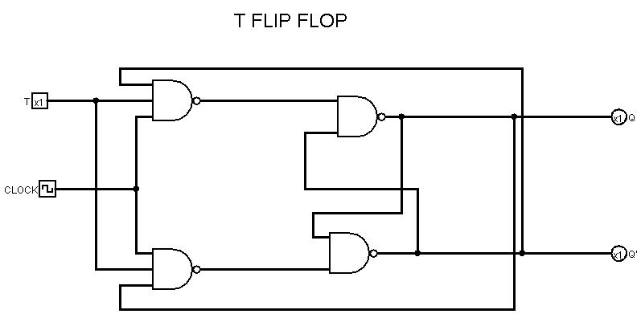
Logisim: T Flip-Flop
Working
JK circuit with J and K joined as T.
T = 0: output holds.
T = 1: output toggles each clock pulse.
Runs at half the clock frequency.

Slide 9
D Flip-Flop
D | Q next | Action
0 | 0 | Reset
1 | 1 | Set
Symbol (edge-triggered)
D
Q
Key points
D
Characteristic equation: Q next = D.
Made from an SR design with S = D and R = D' (an inverter), so S = R = 1 never occurs.
Acts as a one-clock delay; the building block of registers and shift registers.
Hold and toggle behaviour need extra gating, so JK and T are used for those.
CLK
Q'
Q copies D at the clock edge

Slide 10
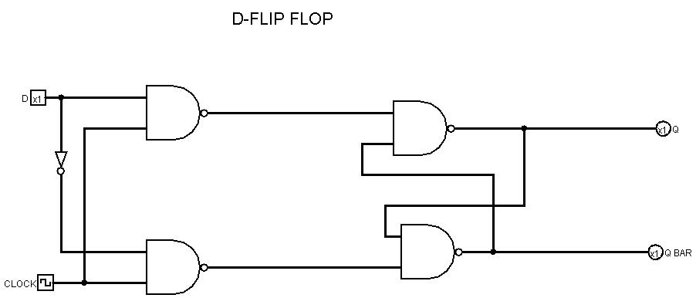
Logisim: D Flip-Flop
Working
Inverter gives the gated NAND stage D and D'.
CLOCK = 1: Q follows D.
CLOCK = 0: Q holds its last value.
S = R = 1 can never occur.

Slide 11
Level vs Edge Triggering
Level-Triggered
Edge-Triggered
Output follows the inputs for as long as CLK is at its active level.
Output updates only at the instant of a clock transition.
CLK
CLK
Shaded: latch is transparent while CLK = 1
Input glitches can pass through
Our Logisim circuits work this way
Orange dot: inputs sampled at the rising edge
Ignores changes between edges
Stable; used in JK, T and D flip-flops
Notes:
SR latch is level-sensitive. Flip-flops are edge-triggered, so they sample inputs only on a clock edge.

Slide 12
Conclusion
Outcomes
Applications
SR, D, JK and T designs built and verified in Logisim.
Truth tables matched the simulated outputs.
Level triggering is simple but unstable; edge triggering is reliable.
Registers and shift registers (D)
Counters and frequency dividers (T, JK)
Memory cells, switch debouncing (SR)
State machines in processors
Possible improvements: master-slave JK, asynchronous preset / clear, and a 4-bit register or counter built from these cells.

Slide 13
Thank You
Faculty: Tanmoya Ghosh Mam
Yushwadeep Reddy · Sai Bhanumathi · Naman Venkat · Narasimha Reddy

